Slide 1

HEALTH CAMPAIGNS

Slide 2
Lesson 1
Learning Intentions
To obtain information on the nature of social marketing campaigns
Success Criteria
Attended a presentation
Responded to questions

Slide 3

Definition
A health campaign is…

Slide 4
Definition
A health campaign is a type of media campaign which promotes public health.
use education along with opportunities for people to participate further.
may have relevance to many different groups, from a local to a global scale.
The goals of health campaigns are to create positive change for health by changing people’s attitudes, external structures, and behaviour.

Slide 5

Types of health campaigns
There are four main types of health campaigns:

Slide 6

Types of health campaigns
Health education
Many diseases and medical problems have a ‘health education campaign’ or ‘awareness campaign’ associated with them.
The goal of such a campaign is to make people conscious of the effects of diseases and to provide them with information about the disease if they want to learn more about it.

Slide 7
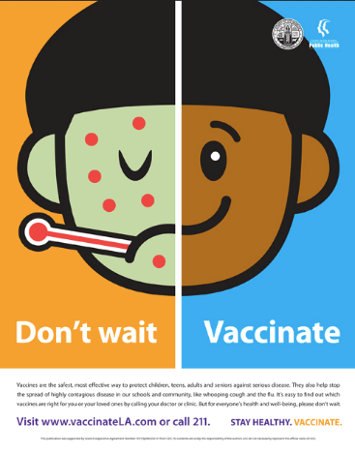
Types of health campaigns
Eradication of infectious diseases
Various health campaigns have taken the goal of eradicating infectious diseases. In such campaigns the organisers recruit the public to participate in the campaign by talking about it with others and encouraging others to participate.

Slide 8
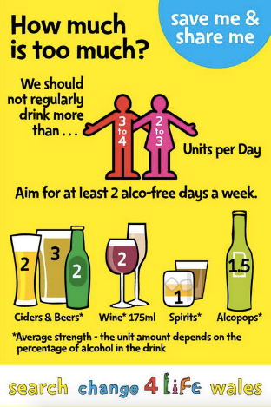
Types of health campaigns
Behaviour modification
These campaigns ask for participants to change their behaviour in some way.
Examples include projects such as quit smoking, HIV prevention campaigns which ask people to use condoms, and exercise campaigns which encourage people to do physical activity for health.

Slide 9

Types of health campaigns
Organisations as campaigns
In some cases the work of an organisation may itself be a health campaign.
For example, where an organisation exists to provide health information or medical resources to people who request them. The organisation itself may conduct series of health campaigns.

Slide 10
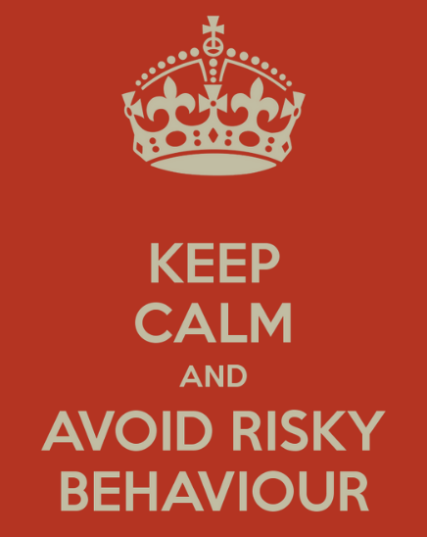
What changes behaviour?
A range of types of interventions aim to change ‘risky’ behaviours:

Slide 11
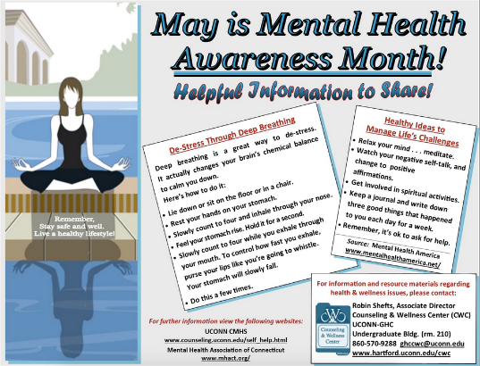
What changes behaviour?
Knowledge and awareness
Increasing knowledge and awareness of risks (through information and awareness raising), or knowledge and awareness of services to help prevent risks

Slide 12
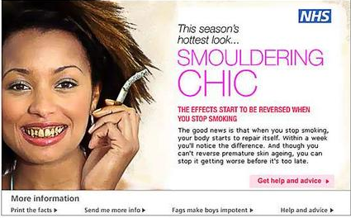
What changes behaviour?
Changing attitudes and motivation
For example: through messages aimed at young people about the harm smoking does to skin and appearance

Slide 13
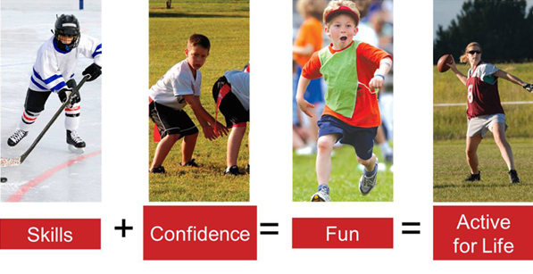
What changes behaviour?
Increasing physical or interpersonal skills

Slide 14

What changes behaviour?
Changing beliefs and perceptions
For example:
through interventions aimed at increasing breast or testicular self- examination by raising awareness of risk and ‘normalising’ self examination

Slide 15
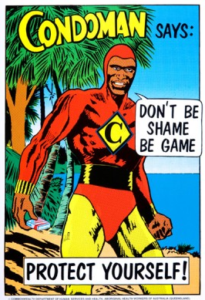
What changes behaviour?
Influencing social norms
For example:
changing public perceptions or public acceptance

Slide 16

What changes behaviour?
Changing structural factors and influencing the wider determinants of health
For example: by implementing clean-air policies to decrease pollution and improve health (removing lead from petrol)

Slide 17
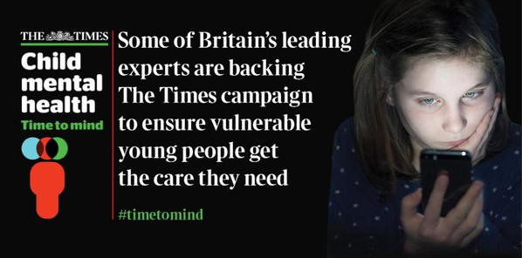
What changes behaviour?
Influencing the availability and accessibility of health services

Slide 18

What is effective?

Slide 19

What is effective?
be clear about the intervention aimed for
intervene at multiple levels when appropriate
target and tailor your message for the audience (age, gender, culture, etc)
provide basic, accurate information through clear, unambiguous messages
join up with community health services
work with community members as advocates
provide alternative choices and risk reduction (eg promoting condom use), rather that simply telling people not to do something (eg don’t have sex)
address peer norms and social pressures.
The key elements for success in changing behaviour:

Slide 20
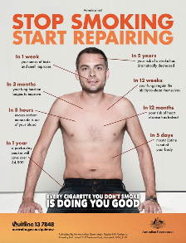
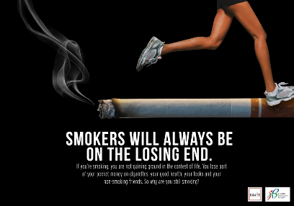
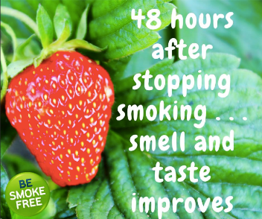
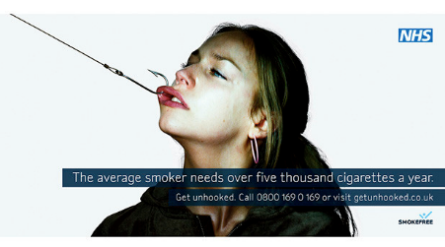
What is effective?
Campaign examples
Media campaigns can change behaviour.
Successful anti smoking campaigns highlight some lessons which may be of general value:

Slide 21
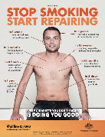
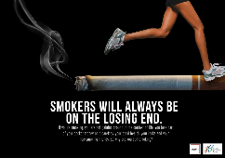


What is effective?
Campaigns need to contain a variety of messages– ‘threatening’ and ‘supportive’ styles of delivery can complement each other
Anti-smoking advertising has to compete in a crowded media marketplace – a hook is needed to engage the emotions of the target audience
Emotions can be engaged using humour, fear, sympathy or aspiration
Smokers want help and encouragement to quit
Advertising should not tell people what they should do
Smokers are motivated by knowing that they are not alone, and that support and help are available – they need reminding of the benefits of not smoking
Content and style of delivery are of equal importance – smokers can accept unpalatable messages if the context is encouraging and supportive.

Slide 22
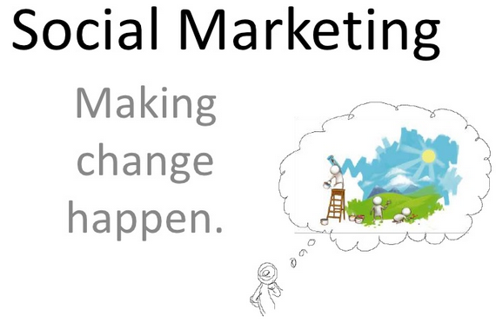
Social marketing
Social marketing is the use of marketing principles to influence human behaviour in order to improve health or benefit society.

Slide 23

Social marketing
Fasten your seat belt.
Eat more fruit.
Pull over to use your mobile phone.
Don't litter.
Get a mammogram.
Talk to your doctor
Look at these sentences.
What do the words in red have in common?

Slide 24
Social marketing
Fasten your seat belt.
Eat more fruit.
Pull over to use your mobile phone.
Don't litter.
Get a mammogram.
Talk to your doctor
These words describe problems to be addressed by changing behaviour.
You need to understand your target audience and make realistic goals for behaviour change

Slide 25

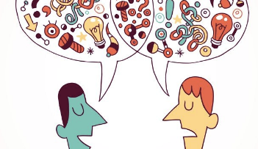

Social marketing as about
Identifying the target audience
Describing the benefits you offer
Creating effective interventions

Slide 26
Social marketing
Attention Gain the audience’s attention
Interest Maintain their interest
Desire Encourage them to desire what you are promoting (appeals)
Action Get them to take action
Social marketing is a form of advertising. Remember AIDA - what advertisers have to do to create a successful advertisement:

Slide 27
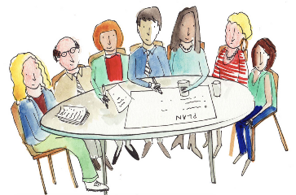
Social marketing
Review information to define the problem (What's out there?)
Set communication objectives (What do we want to accomplish?)
Analyse and segment target audiences (Who do we want to reach?)
Develop and pre-test message concepts (What do we want to say?)
Select communication channels (Where do we want to say it?)
Select, create and pre-test messages and products (How do we want to say it?)
Develop promotion plan/production (How do we get it used?)
Implement communication strategies and conduct process evaluation (Getting it out there)
Conduct outcome and impact evaluation (How well did we do?)
Planning
These steps are essential to the strategic planning for an effective health campaign:

Slide 28

Elements of health campaigns
Posters
Slogans and taglines
Repeated formats
Variety for different media or sections of the audience

Slide 29

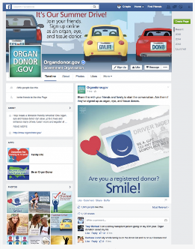
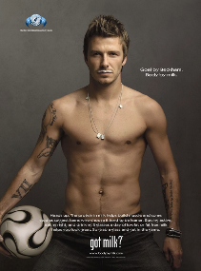

Elements of health campaigns
CAMPAIGNS MAY ALSO HAVE:
Social media profile eg Facebook page
Online community
Related games, entertainment
Educational material
Quizzes, fact sheets
Competitions
Rewards, prizes
Tie ins with big events eg Olympics
Sponsorship exposure eg sporting teams
Connections with celebrities, organisations, people with high social media presence
Fictional characters or mascots
Video/YouTube
Volunteers, personal connections
Events

Slide 30
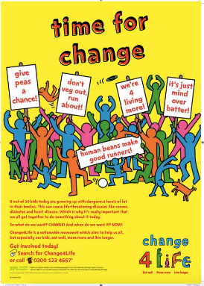
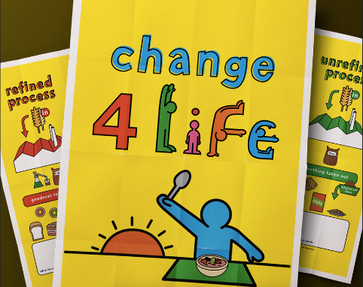

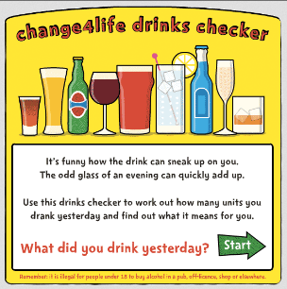
Examples of health campaigns
CHANGE 4 LIFE
A Welsh campaign to help families to be more healthy and live longer

Slide 31




Examples of health campaigns
CONSENT IS SEXY
A campaign to promote awareness among South African students about consent and respect – to reduce conflict within relationships and to reduce sexual assault and rape.

Slide 32
Lesson 2
Learning Intentions
To consider the elements of social marketing campaigns
Success Criteria
Completed brainstorm
Identified other campaign examples

Slide 33
Lesson 3
Learning Intentions
To establish ground rules for group discussions
To establish a topic for the health campaign
Success Criteria
A plan for group work is established

Slide 34
Lesson 4
Learning Intentions
To identify the problem; the objective, the target audience and the contents
Success Criteria
Discussed an completed responses to Questions 1, 2, 3 and 4

Slide 35
Tasks
What are the task requirements?
Decide on a campaign: topic Group audience information
Decide on individual tasks and media types Print: ads, posters, billboards TV: adverts; interviews; current affairs Social: FB; Instagram; Twitter

Slide 36
Group Planning
Mental health in the classroom
Print
Billboard Poster:
How to avoid homicide
Social Media
Twitter
Teachers are people too
Television
Current Affairs
The stresses that teachers experience

Slide 37
Individual Planning
State
media type
purpose/aim
Target audience
Contents – image/feed/etc
Explain
How media relates to aim and audience
How contents relates to aim and audience

Slide 38
Lesson 5
Learning Intentions
To identify the forms of communication, strategies to use, how to implement them and how to assess the success.
Success Criteria
Discussed an completed responses to Questions 5 to 8

